Slide 1

Logistic Regression
TAG-J

Slide 2
When and why do we use Logistic Regression?
Binary
Multinomial
Theory Behind Logistic Regression
Assesing the Model
Assesing predictors
Things that can go Wrong
Interpreting Logistic Regression
AIMS

Slide 3
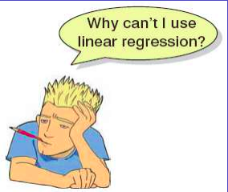
When And Why?
To predict an outcome variable that is categorical from one or more categorical or continuous predictor variables.
Used because having a categorical outcome variable violates the assumption of linearity in normal regression.
Does not assume a linear relationship between DV and IV
footer

Slide 4
When And Why
No assumptions about the distributions of the predictor variables.
Predictors do not have to be normally distributed
Logistic regression does not make any assumptions of normality, linearity,
and homogeneity of variance for the independent variables.
Because it does not impose these requirements, it is preferred to discriminant analysis when the data does not satisfy these assumptions.

Slide 5
Logistic Regression
Logistic regression is a supervised learning classification algorithm.
It is used for predicting the categorical dependent variable using a given set of independent variables.
A logistic regression model predicts P(Y=1) as a function of X.
It is one of the simplest ML algorithms that can be used for various classification problems such as spam detection, Diabetes prediction, cancer detection etc.

Slide 6
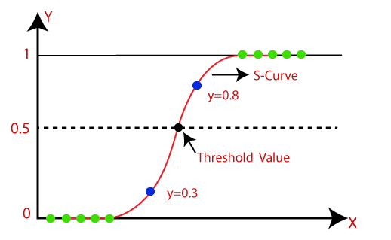
Logistic Regression can be used to classify the observations using different types of data and can easily determine the most effective variables used for the classification.
The below image is showing the logistic function:
CHMI | Q4 2020

Slide 7
Types of Logistic Regression
Binomial: In binomial Logistic regression, there can be only two possible types of the dependent variables, such as 0 or 1, Pass or Fail, etc.
Multinomial: In multinomial Logistic regression, there can be 3 or more possible unordered types of the dependent variable, such as "cat", "dogs", or "sheep“
Ordinal: In ordinal Logistic regression, there can be 3 or more possible ordered types of dependent variables, such as "low", "Medium", or "High".
footer

Slide 8

With One Predictor
Outcome
We predict the probability of the outcome occurring
b0 and b0
Can be thought of in much the same way as multiple regression
Note the normal regression equation forms part of the logistic regression equation
CHMI | Q4 2020

Slide 9

With Several Predictor
Outcome
We still predict the probability of the outcome occurring
Differences
Note the multiple regression equation forms part of the logistic regression equation
This part of the equation expands to accommodate additional predictors

Slide 10
Measuring the Probability of Outcome
The probability of the outcome is measured by the odds of occurrence of an event.
If P is the probability of an event, then (1-P) is the probability of it not occurring.
Odds of success = P / 1-P
CHMI | Q4 2020

Slide 11
Measuring the Probability of Outcome
Outcome
We still predict the probability of the outcome occurring
Differences
Note the multiple regression equation forms part of the logistic regression equation
This part of the equation expands to accommodate additional predictors
footer

Slide 12

Methods of Regression
Forced Entry: All variables entered simultaneously.
Hierarchical: Variables entered in blocks.
Blocks should be based on past research, or theory being tested. Good Method.
Stepwise: Variables entered on the basis of statistical criteria (i.e.relative contribution to predicting outcome).
Should be used only for exploratory analysis

Slide 13
DECISION PROCESS
Stage 1:
Objectives Of logistic regression
Identify the independent variable that impact in the dependent variable
Establishing classification system based on the logistic model for determining the group membership
footer

Slide 14
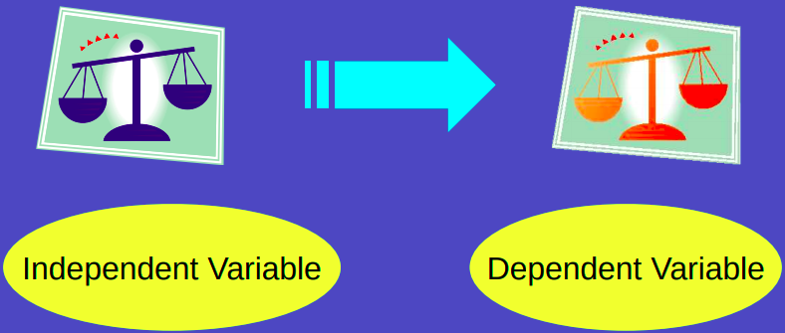
Linear Regression

Slide 15
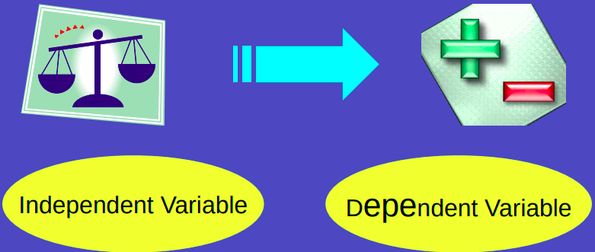
Logistic Regression

Slide 16

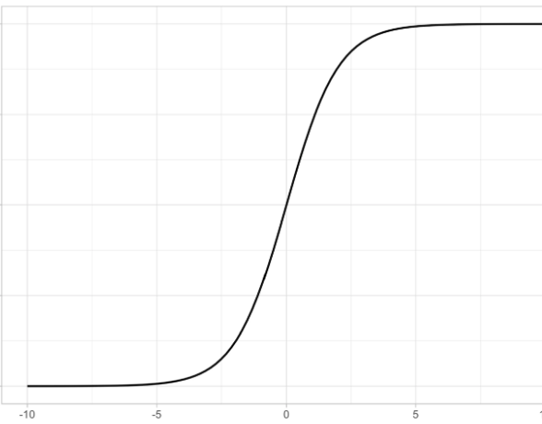
The standard logistic function (or sigmoid function)
Let z be any continuous value whose domain is (-∞, ∞). If you plug z into the sigmoid function like
A nice property of the output is that it is always within 0 and 1.

Slide 17


Here are some properties of θ(z):
1.When z = 0, θ = .5
2.When z is very large, θ is approximately 1
footer

Slide 18

3.When z is very small/negative, θ is approximately 0
We can use the sigmoid function to convert a continuous, unbounded output z to a decimal number θ ∈ (0,1), which is advantageous for representing probabilities.

Slide 19


Converting linear regression outputs into logistic regression outputs with the sigmoid function
To go from a linear regression to a logistic regression, we can substitute the OLS output:
For z like so:
This function reinterprets the OLS output as a probability.
The formula above represents the output of a logistic regression model.
footer

Slide 20


Mathematical properties of logistic regression
By isolating y term ,we have:
By substituing y:

Slide 21

Terms to know:
The odds ratio specifies is defined as the probability of success as compared to the probability of failure.
It is another way to represent probability, and is key to the interpretation of logistic regression coefficients.
footer

Slide 22
Two key observations on these terms
In logistic regression, the logit must be linearly related to the independent variables.
This follows from equation A, where the left-hand side is a linear combination of x.
This is analogous to the OLS assumption that y be linearly related to x.

Slide 23

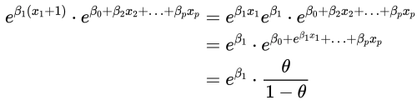
If you increase an independent variable x_i by 1, your odds grow by a factor of exp(β_i)​. This follows from equation B.
Point (2) follows from the algebra below:
Say we want to increase x_i by 1:
Then the odds of success increase by a factor of exp(β_i).
footer

Slide 24
Assumptions of logistic regression
Dependent variable is binary:
If this is not true, then logistic regression outputs do not apply.
Linearity between logit and independent variables:
This follows from equation A — if this condition is not met, logistic regression is invalid.
No multicollinearity:
Multicollinearity distorts tests of statistical significance on regression coefficients.
Large sample size:
This is more of a rule of thumb.

